Slide 1
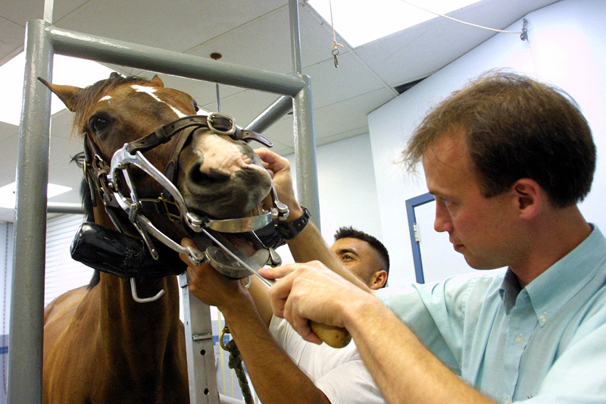
Parasite Identification Vet Science CDE

Slide 2
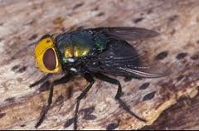
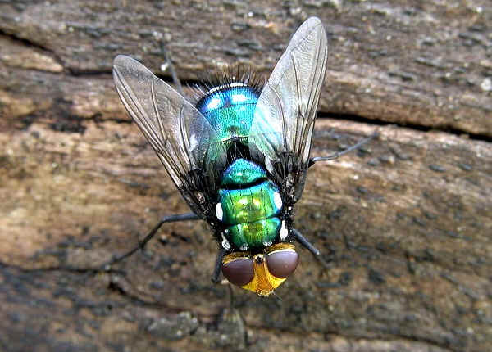
Blowfly- 300 (Family Calliphoridae)

Slide 3
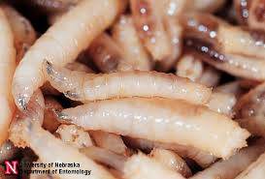
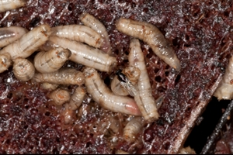
Blowfly Maggot- 301 (Family Calliphoridae)

Slide 4
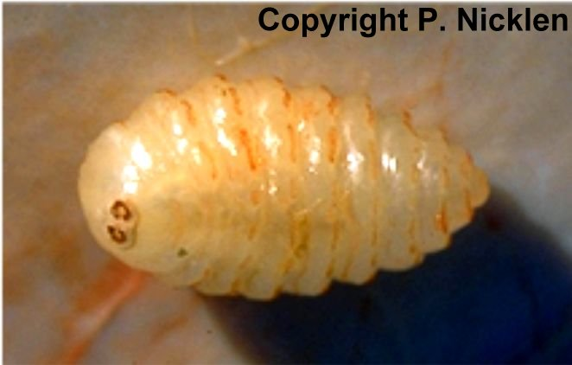
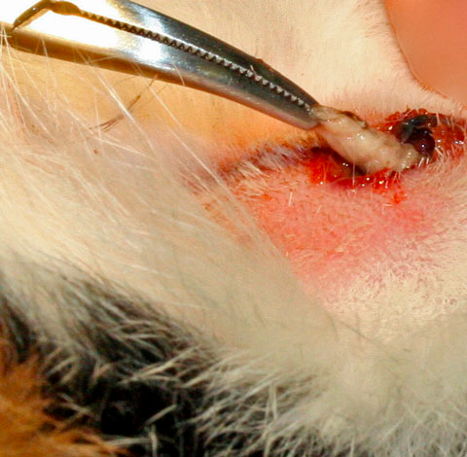
Cat Warble- 302 (Genus Cuterebra)

Slide 5
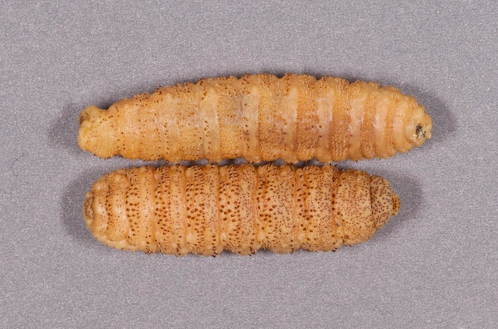
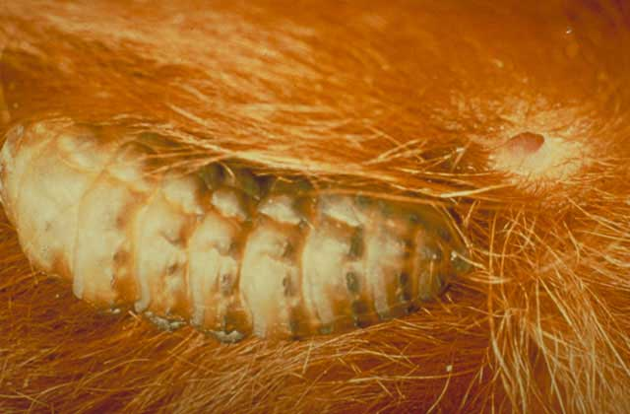
Cattle Grub- 303 (Genus Hypoderma)

Slide 6
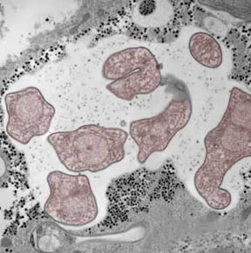
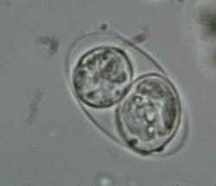
Coccidia- 304 (Genus Isospora or Eimeria)

Slide 7
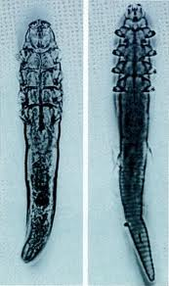
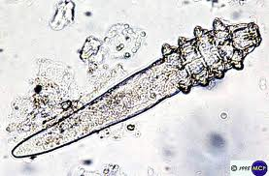
Demodectic Mite- 305 (Genus Demodex)

Slide 8
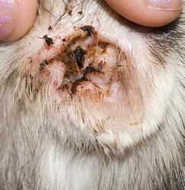
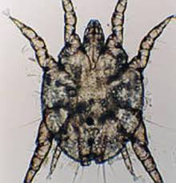
Ear Mite- 306 (Family Ascaridae; Genus Otodectes)

Slide 9
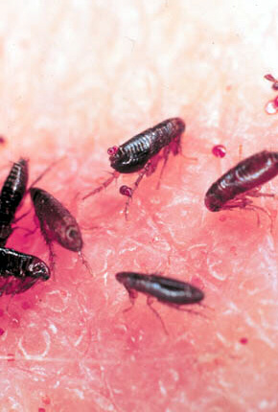
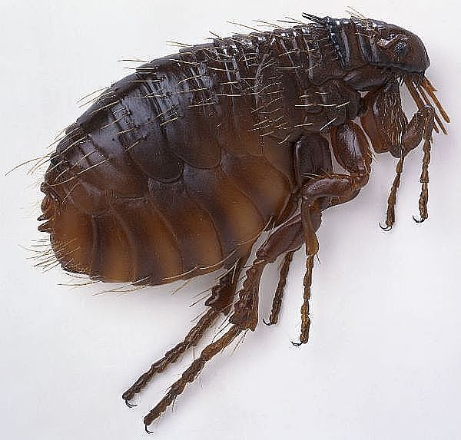
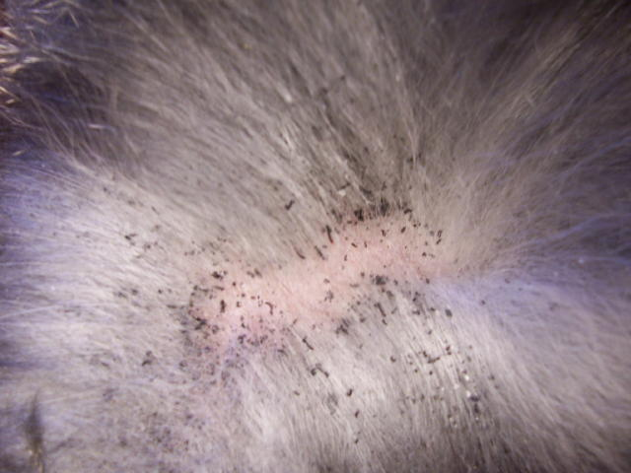
Fleas- 307 (Genus Ctenocephalides)

Slide 10
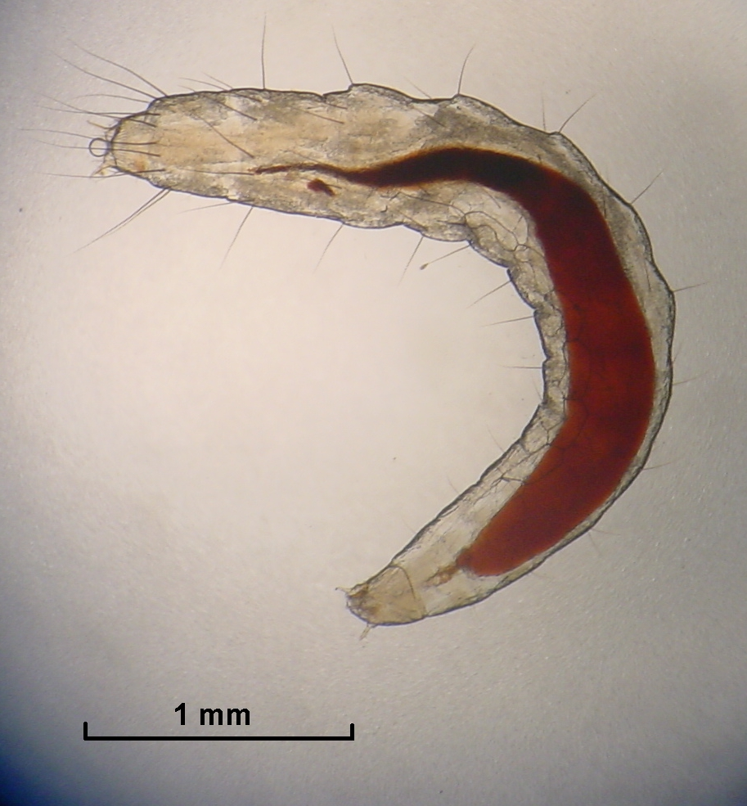
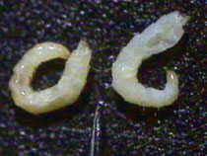
Flea Larva- 308 (Genus Ctenocephalides)

Slide 11
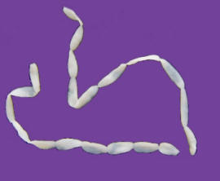
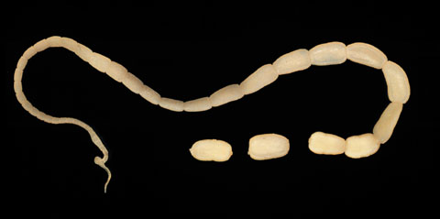
Flea Tapeworm- 309 (Genus Dipylidium)

Slide 12
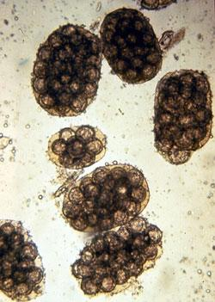
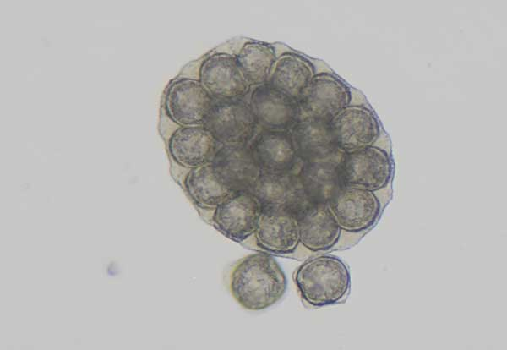
Flea Tapeworm Egg- 310 (Genus Dipylidium)

Slide 13
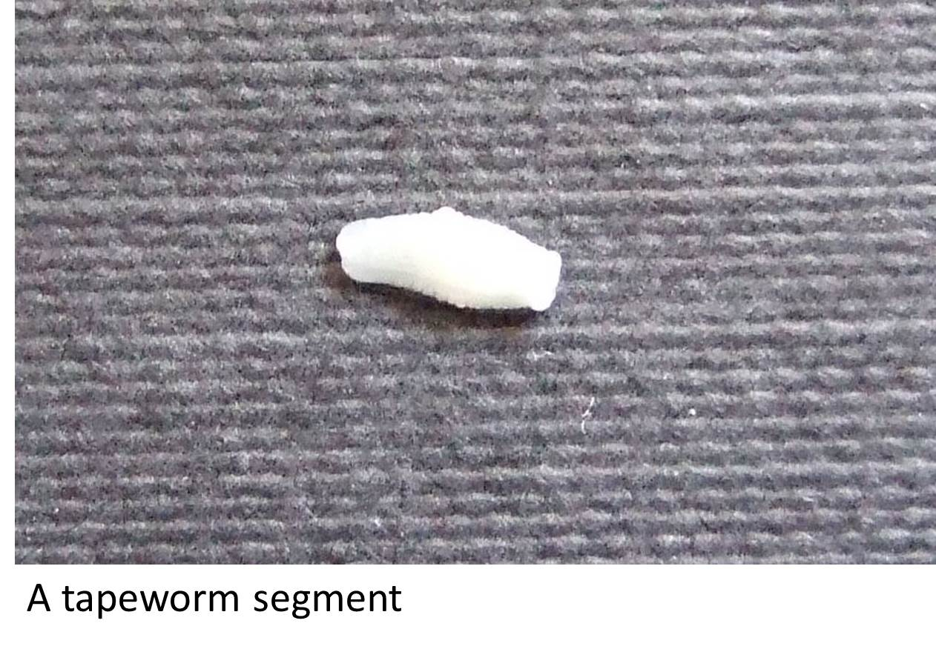
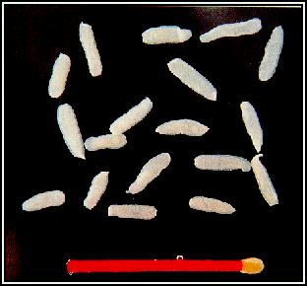
Flea Tapeworm Segment- 311 (Genus Dipylidium)

Slide 14
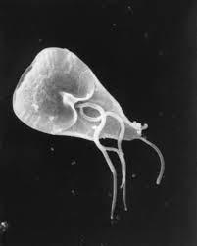
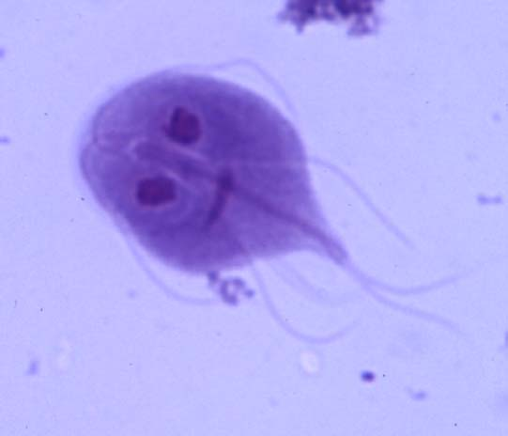
Giardia- 312 (Genus Giardia)

Slide 15
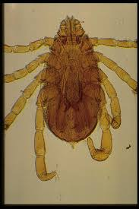
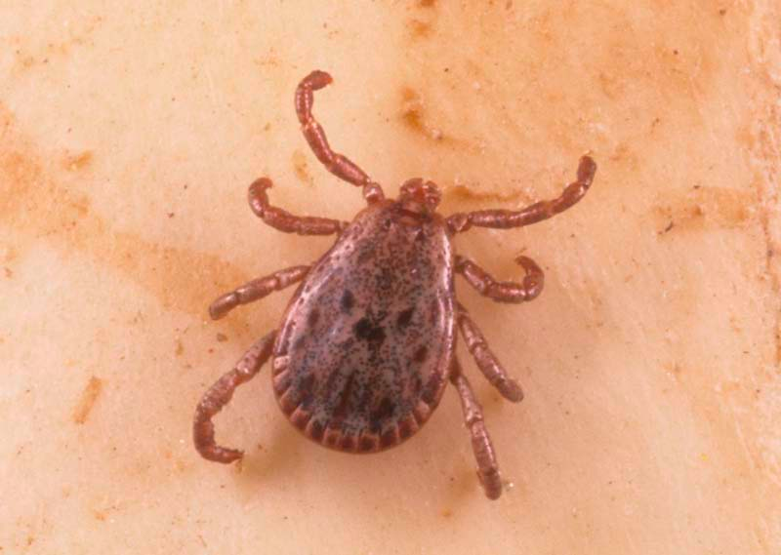
Hard Tick- 313 (Family Ixodidae, Genus Amblyomma or Dermacentor)

Slide 16
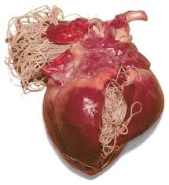
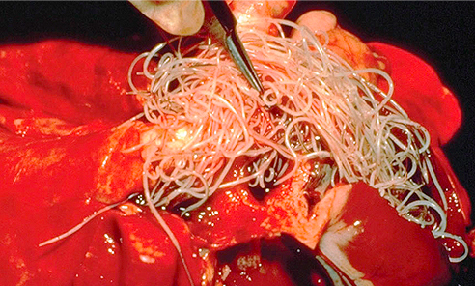
Heartworm Adult- 315 (Genus Dirofilaria)

Slide 17
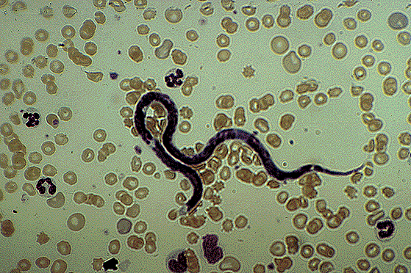
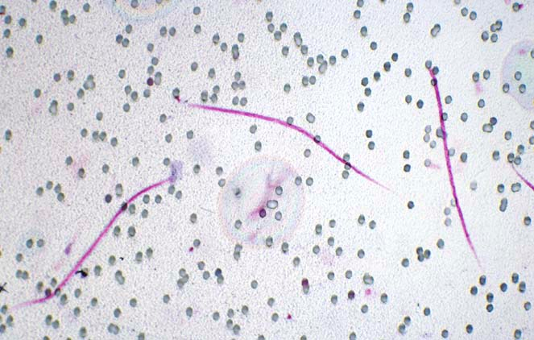
Heartworm Microfilaria- 316 (Genus Dirofilaria)

Slide 18
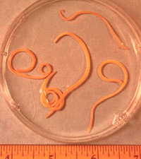
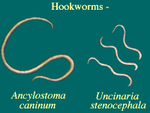
Hookworm Adult- 317 (Family Ancylostomatidae, Genus Ancylostoma)

Slide 19
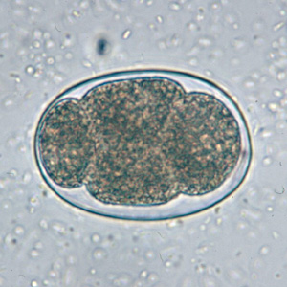
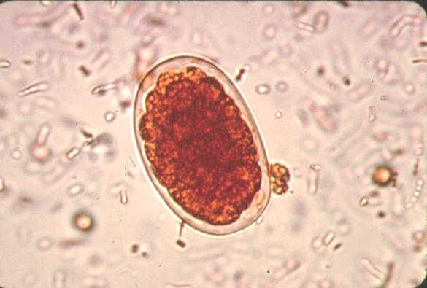
Hookworm Egg- 318 (Family Ancylostomatidae, Genus Ancylostoma)

Slide 20
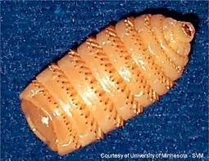
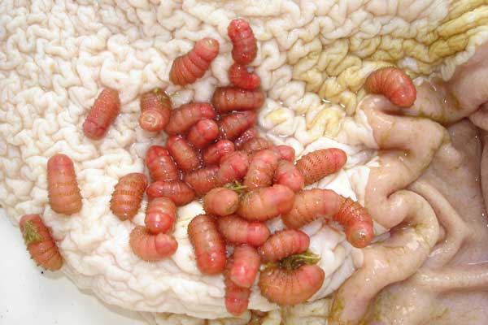
Horse Bots- 319 (Genus Gasterophilus)

Slide 21
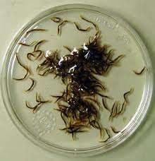
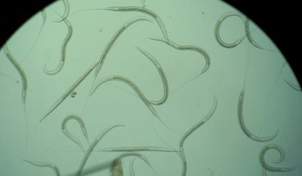
Horse Strongyles- 320 (Family Strongylidae; Genus Strongylus)

Slide 22
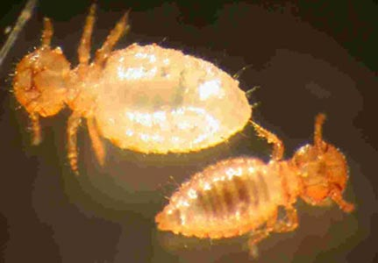
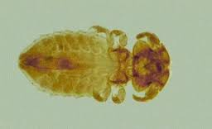
Lice- Biting 321 (Order Mallophaga; Genus Bovicula)

Slide 23
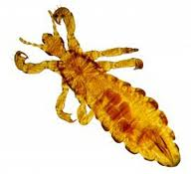
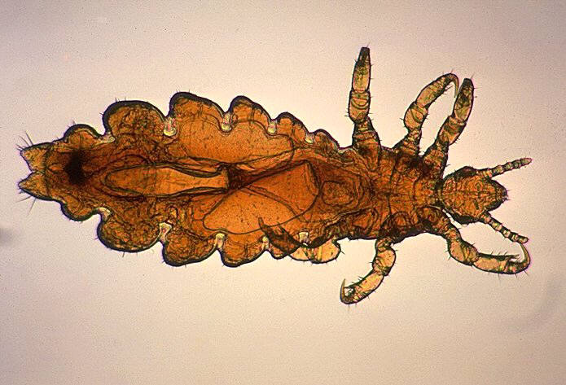
Lice- Sucking 322 (Order Anoplura, Genus Linognathus)

Slide 24
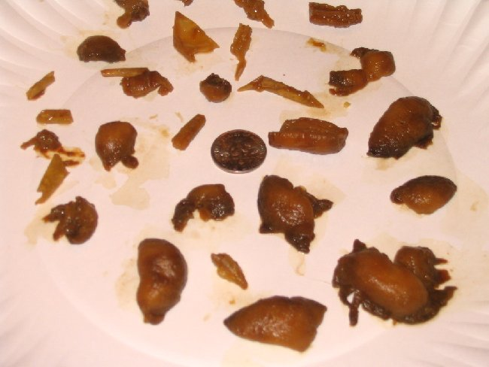
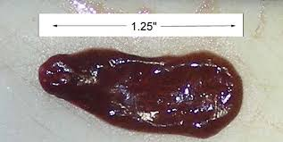
Liver Fluke-323 (Class Trematoda; Genus Fasciola)

Slide 25
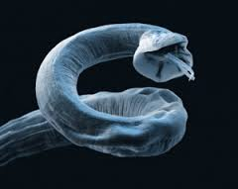
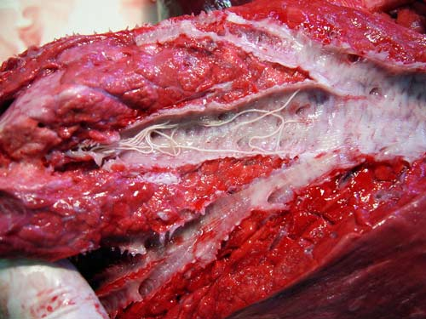
Lungworm- 324 (Family Metastronglyidae; Genus Metastronglydus)

Slide 26
Mosquito Adult- 325 (Family Culicidae, Genus Anopheles)

Slide 27
Mosquito Larva-326 (Family Culicidae, Genus Anopheles

Slide 28
Pinworm- 327 (Genus Oxyuris)

Slide 29
Roundworm Adult- 328 (Family Ascarididae, Genus Toxocara)

Slide 30
Roundworm Egg- 329 (Family Ascarididae, Genus Toxocara)

Slide 31
Sarcoptic Mite- 330 (Family Ascaridae, Genus Sarcoptes)

Slide 32
Taenia Tapeworm- 331 (Family Taeniidae, Genus Taenia)

Slide 33
Taenia Tapeworm Egg- 332 (Family Taeniidae, Genus Taenia)

Slide 34
Taenia Tapeworm Segment- 333 (Family Taeniidae, Genus Taenia)

Slide 35
Whipworm- 335 (Genus Trichuris)

Slide 36
Whipworm Egg- 336 (Genus Trichuris)

